Slide 1

Java Spring, Jenkins and Docker Project
Yuvraj Deshmukh

Slide 2
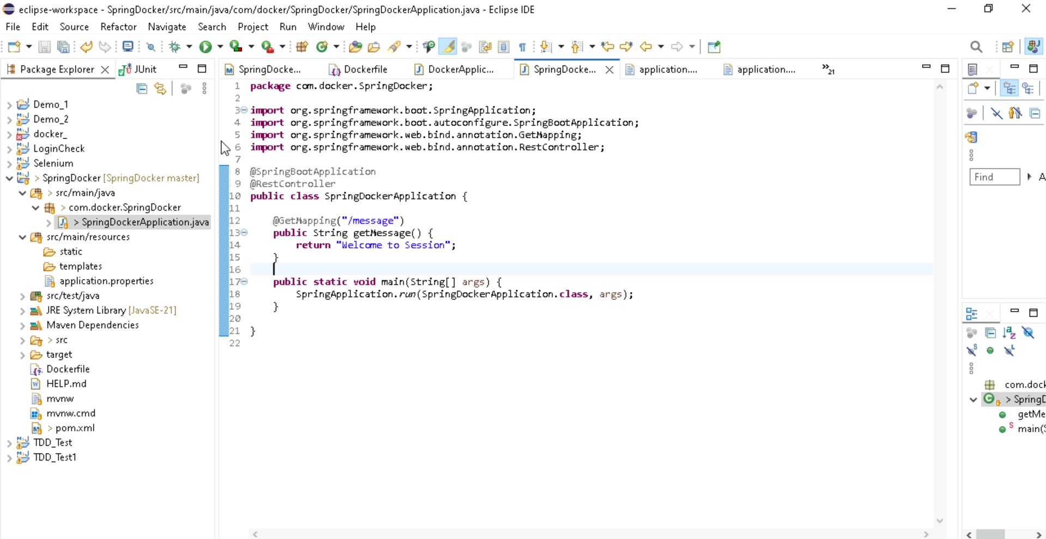
Code Understanding

Slide 3
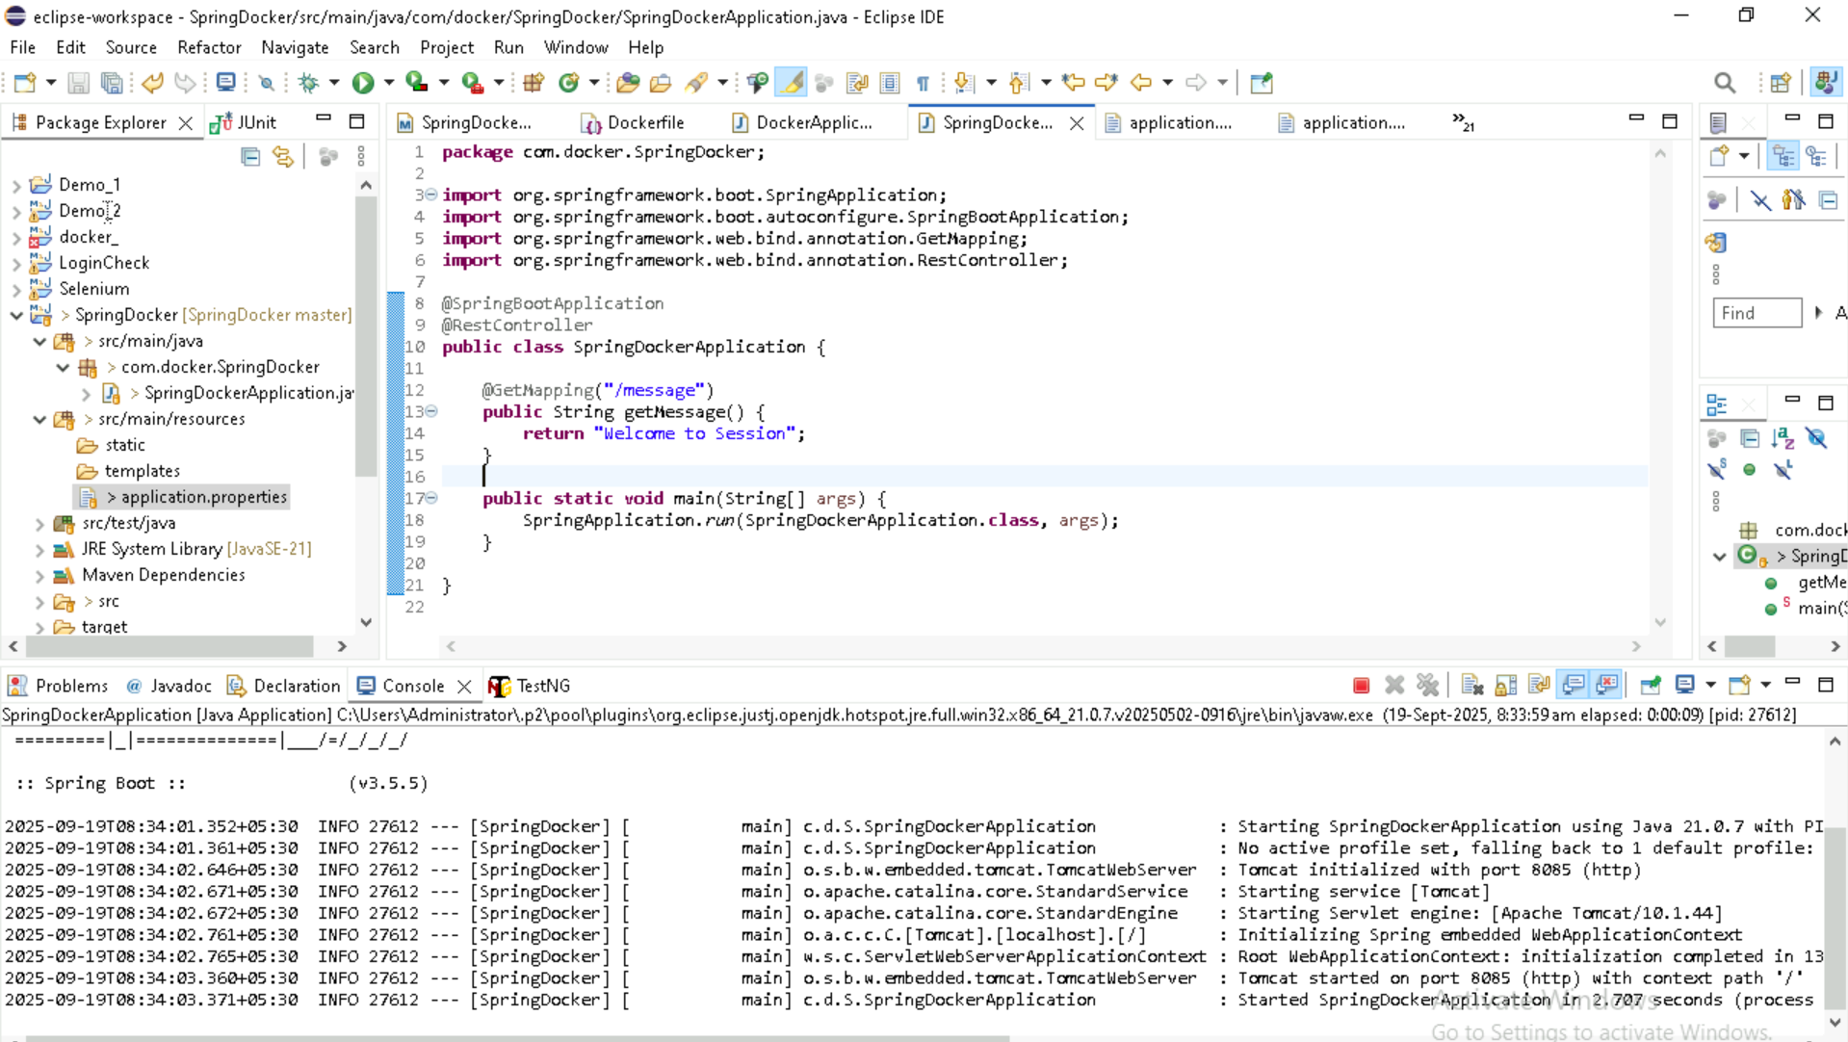
Code Understanding

Slide 4
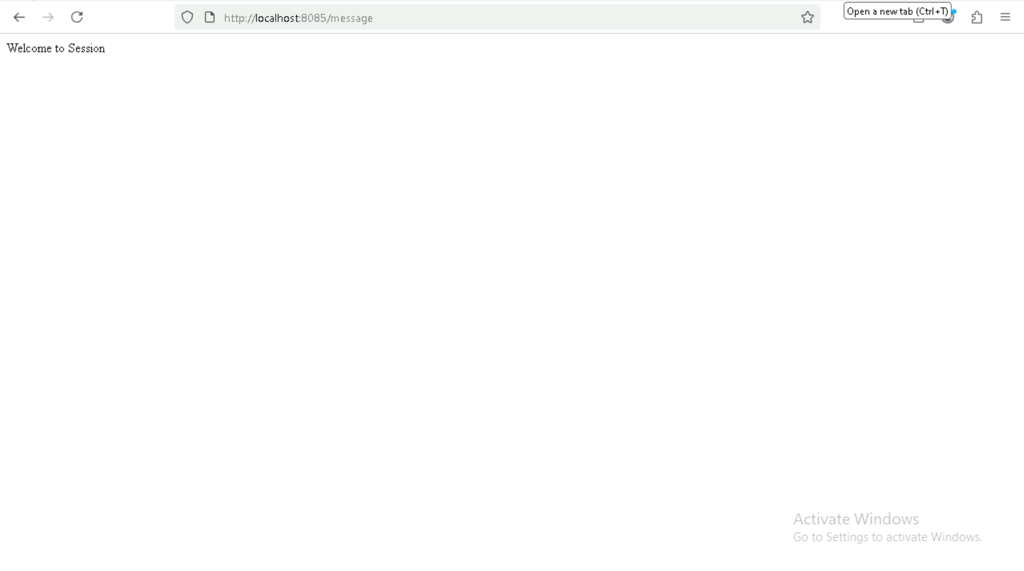
Code Understanding

Slide 5
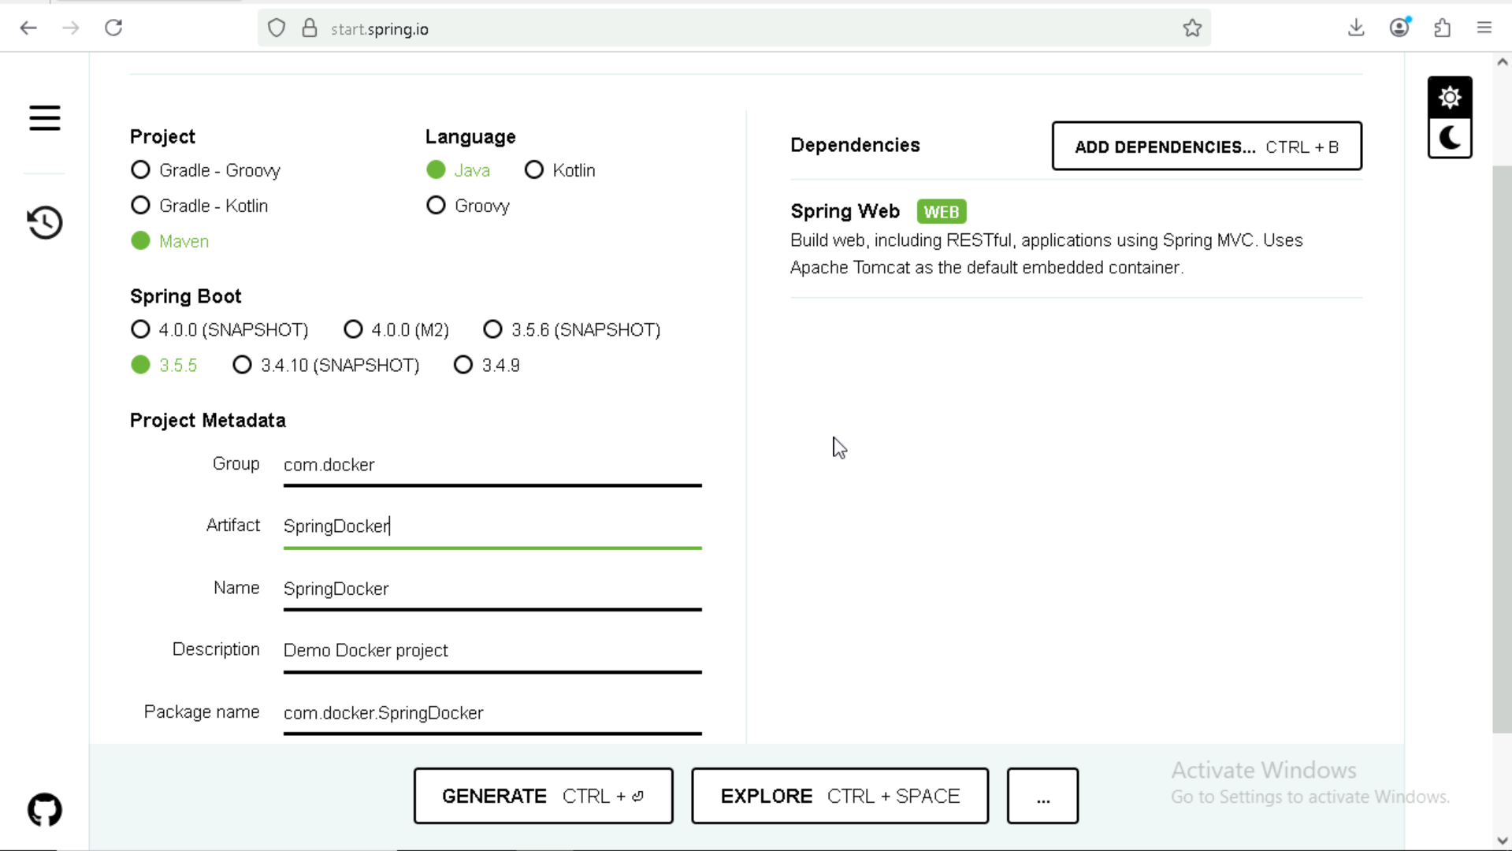
Project Creation
Create a Simple Spring Project from Spring Initilizer

Slide 6
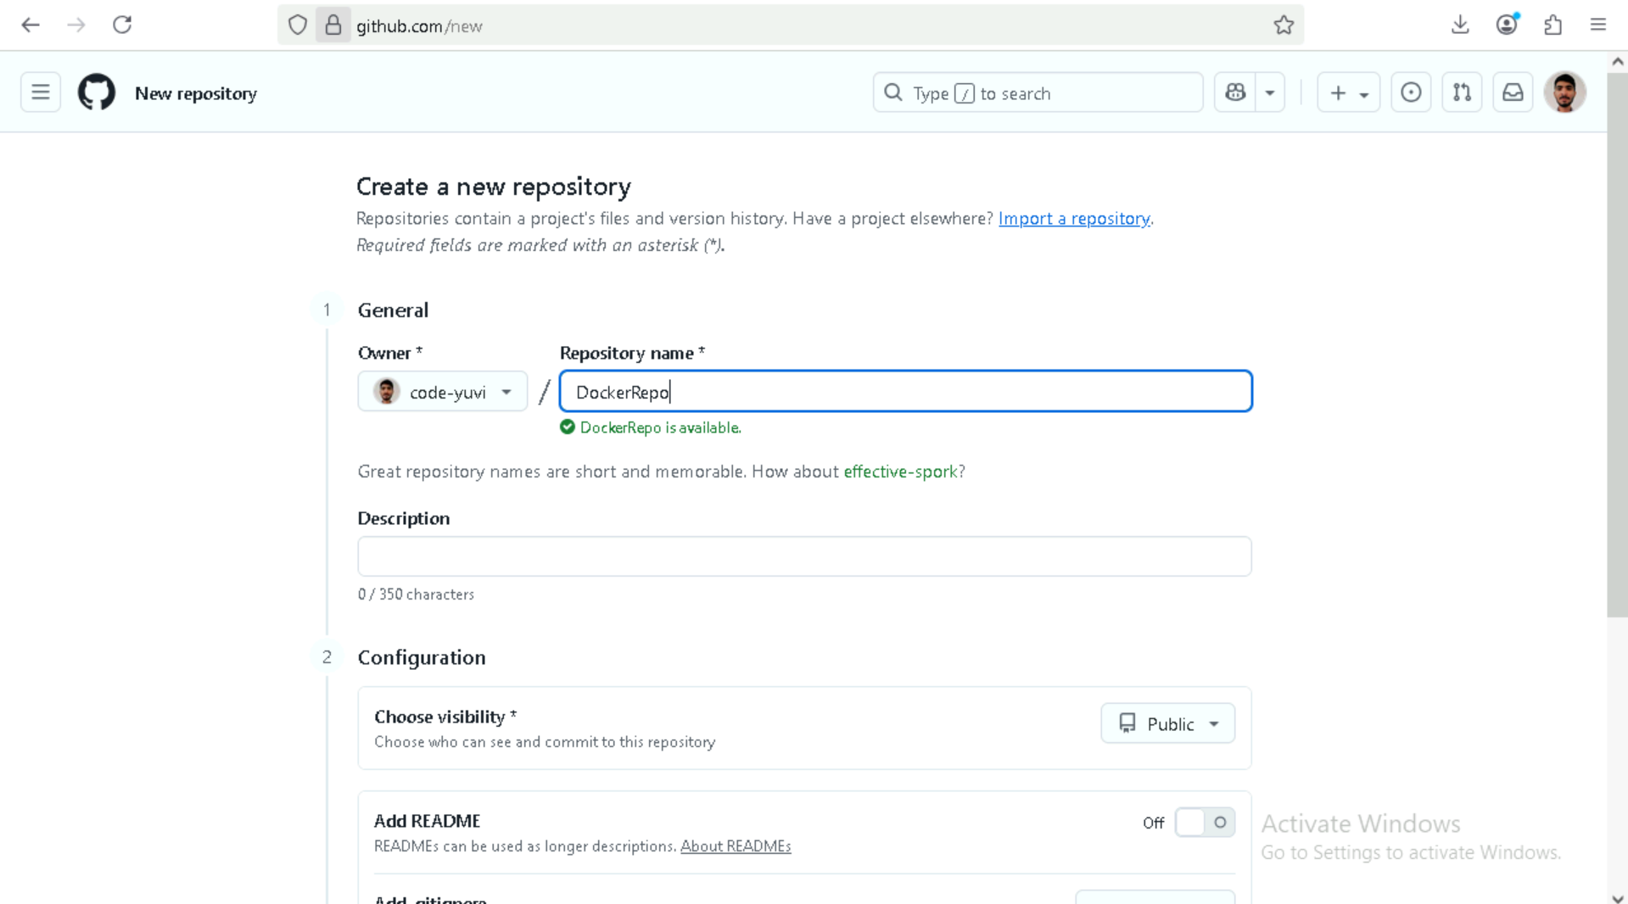
Create a GitHub Repository

Slide 7
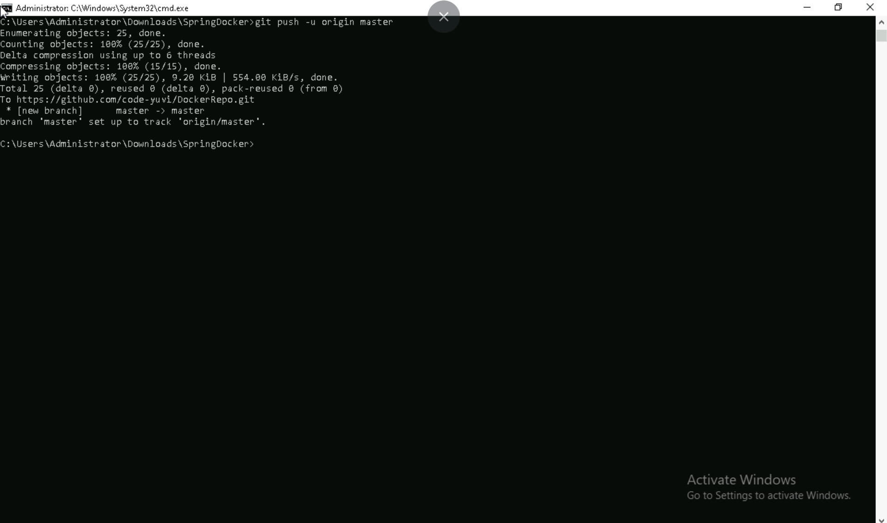
Push the project to git repo

Slide 8
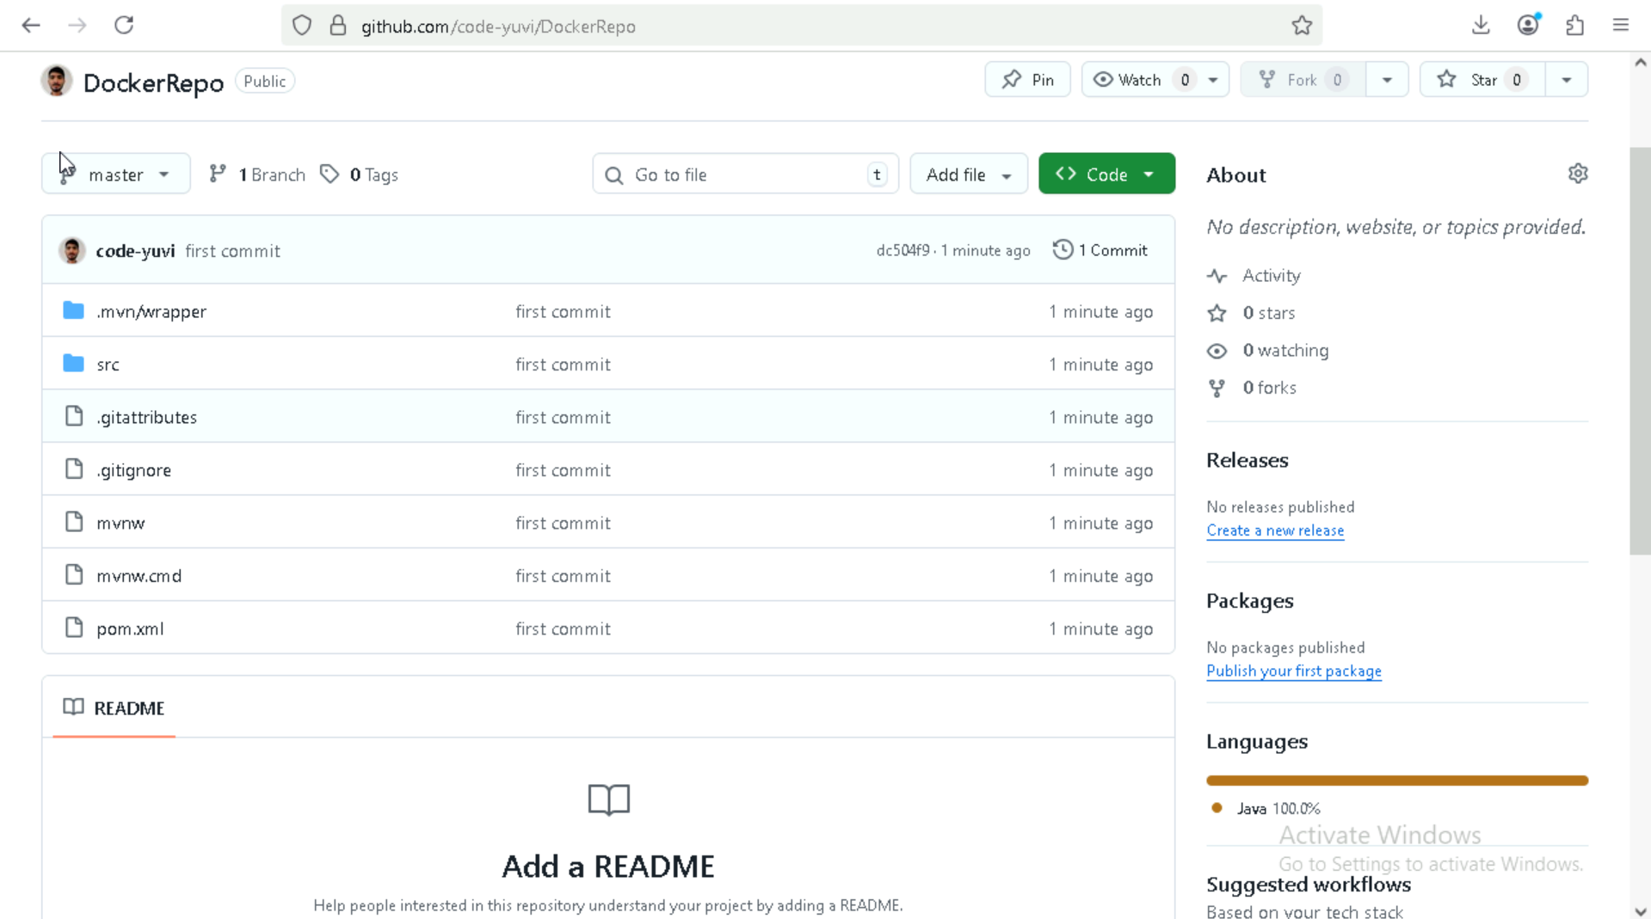
Project repo

Slide 9
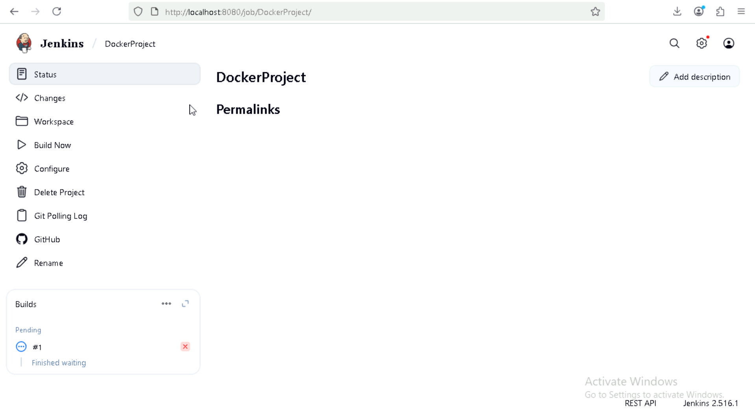
Create a Pipeline on Jenkins through git

Slide 10
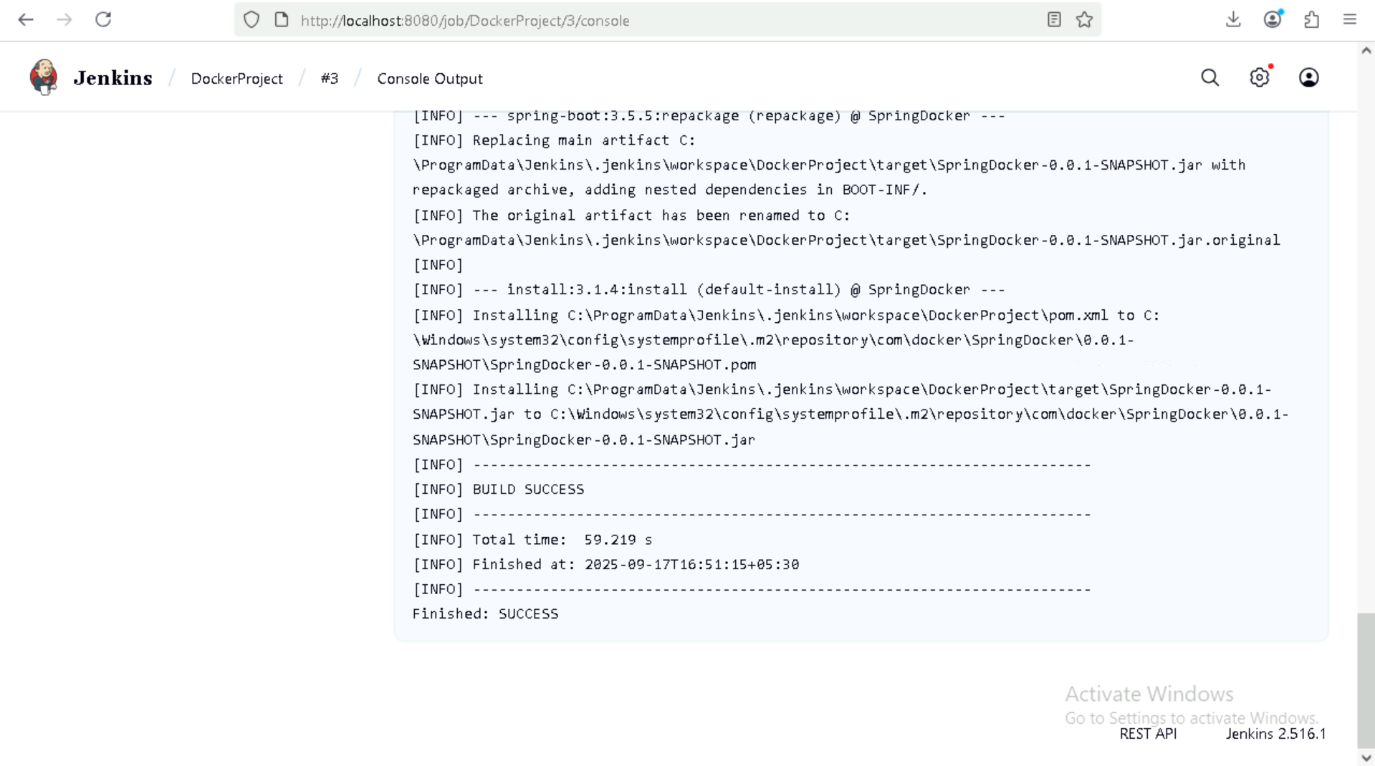
Build the project

Slide 11
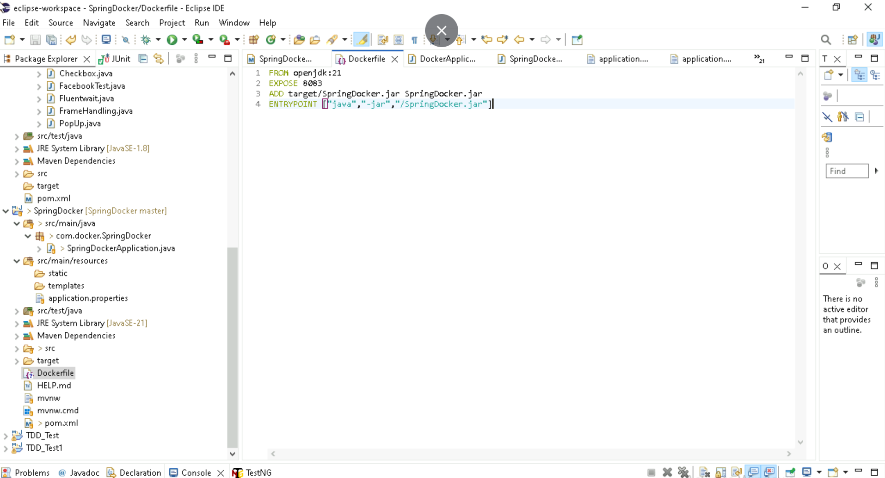
Create a Dockefile to track the project through docker

Slide 12
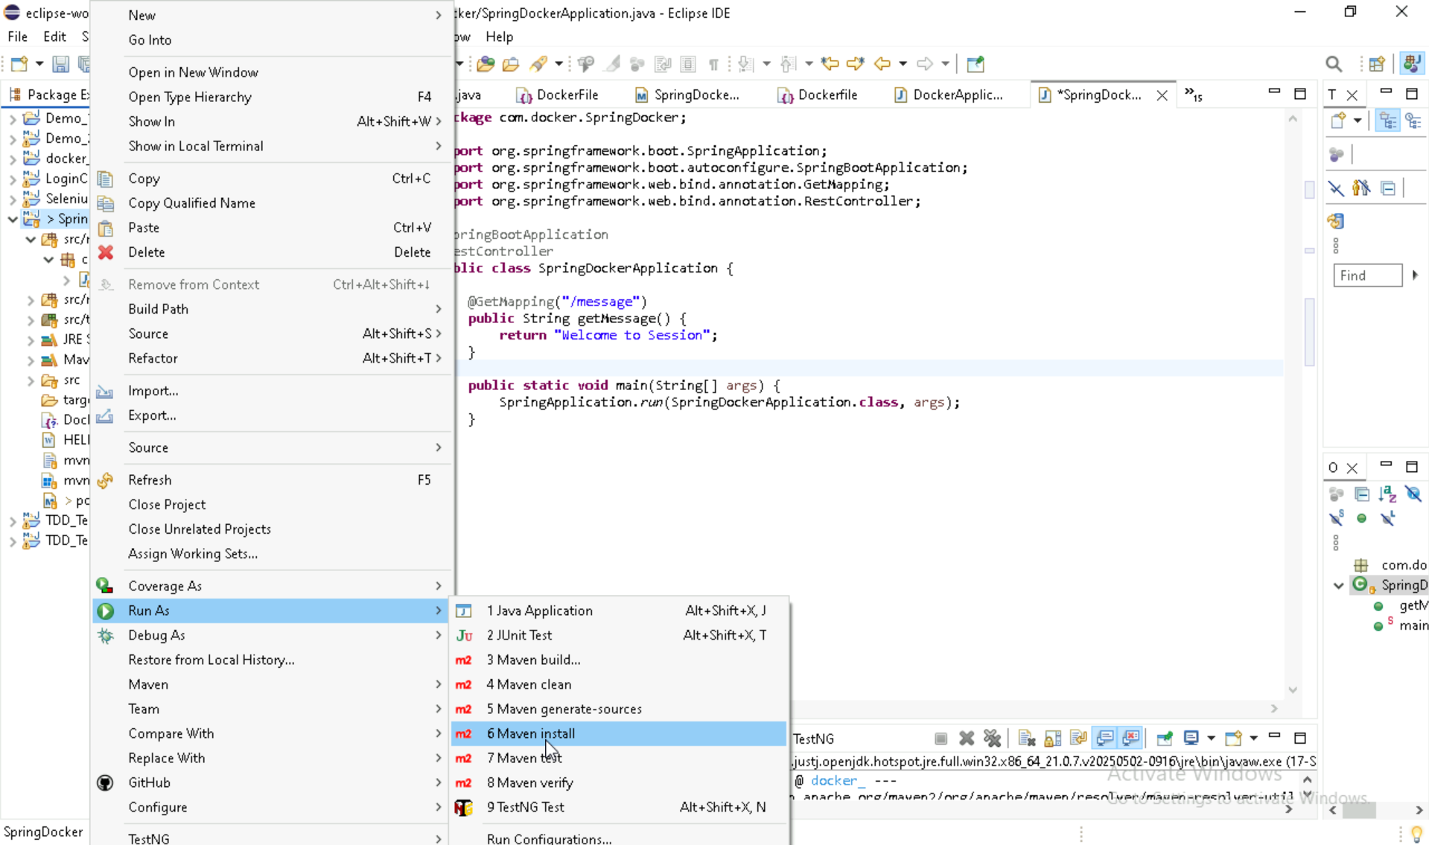
Do maven install to create jar file in target

Slide 13
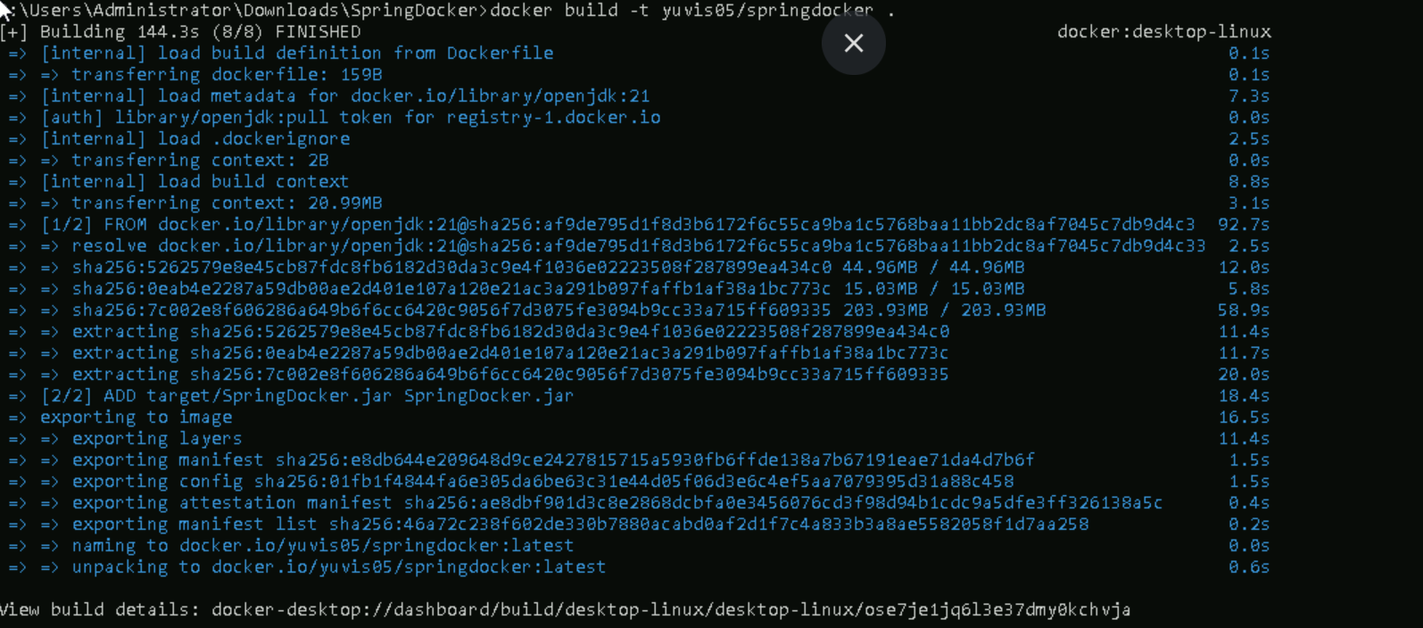
Build the Dockerfile to create Image

Slide 14
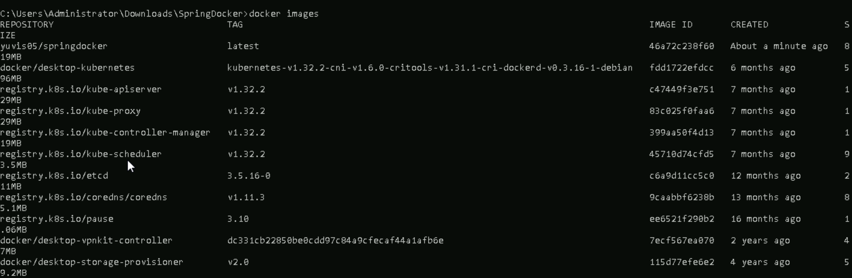
Check Image

Slide 15
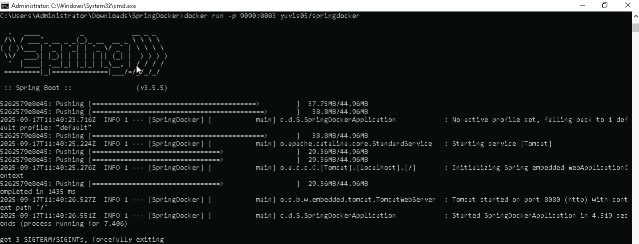
Create a Container from docker Image

Slide 16
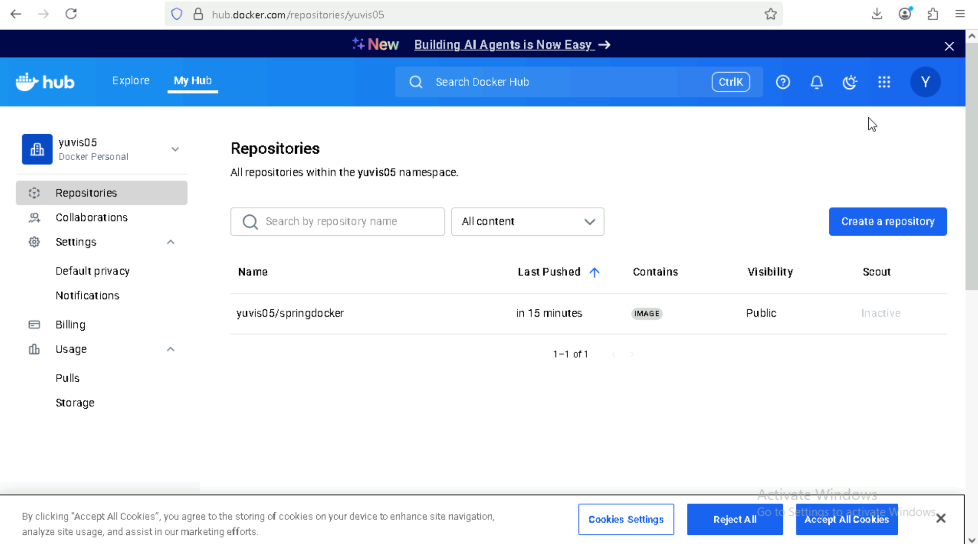
Image uploaded to docker hub

Slide 17
Thank you

